Slide 1
Planning a data story, Finding the data and Cleaning and verifying the data
Prepared by ,
Navaneeth TM,
Research Scholar,
Department of Journalism and Mass Communication,
University of Calicut.

Slide 2
3 Basic stages of Data Journalism
Finding the data
Extracting information out of the data
Communicating the information

Slide 3
Stages of Data Journalism - Elaborated
Planning the data story
Finding the data
Filtering, cleaning, Organising, and verifying the data
Extracting information out of the data – visualising, Statistical tests etc.
Communicating the information – Writing the story, Visualising the information for readers, Verification, Checking feedbacks, Re-editing and updating the story…

Slide 4
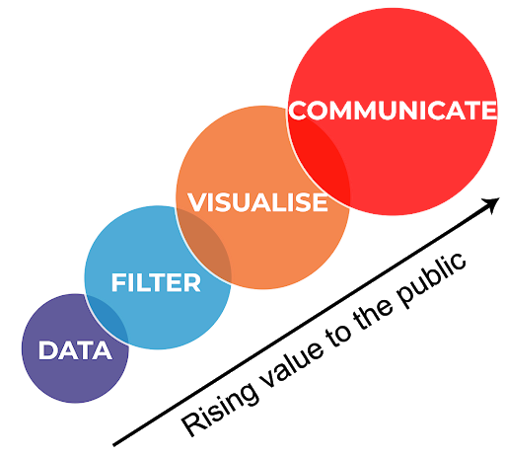
Data Journalism pipeline

Slide 5
Planning a Data Story
1. Story Idea: Starting point of a data story could be either..
The data or
The journalist/ any other
2. Define the angle and ask questions
3. Think of Data sources/ Identify data sources.

Slide 6
Planning a Data Story
4. Thinking of the time, money, data sources → Do we have to proceed with the project?
5. If yes, How many people will get involved and who does what?
6. Do we have to recruit people from outside? → Recruit.

Slide 7
Planning a Data Story
7. Change in plans during the process.

Slide 8
Tip:
If you are alone and your skillset is limited → Do smaller projects. Try to get help from colleagues, Improve your skills. Plan the data story well. Take time.
Skill → Your knowledge in data tools.

Slide 9
Finding the data
Sometime we will have to build a database that supports our story. It will take time and money
We can search for a database that already exists
Verification of data – Source, Content. Ask the 5WH to the data.
How, When, What (Methodology), Where, Why (Purpose), Who (Source, who conducted the data collection)

Slide 10
How to find the data?
Random search on internet > Streamlining the search/Advanced search (search with file type)
Data sites/ repositories (eg: statista)
Open data repositories of government (eg: https://data.gov.in/ , https://www.ecostat.kerala.gov.in/ )
Data from world bank, UN etc. (https://data.un.org/, https://data.worldbank.org/)
Forums
Experts can help to find the resources
RTI

Slide 11
How to find the data?
8. Extract data from websites or pdf
9. Directly contact the organizations that hold the data
10. Google trends and Wikishark trends

Slide 12
Common data formats
Tabular data formats
Csv file (comma separated values)
xls, xlsx : ms excel format; allows multiple worksheets
Geographic data formats
shp – Shapefile – Stores geographic shapes (points, lines, area etc.)
GeoJSON- Geographic JavaScript Object Notation
- geographic shape files in json format. Better for web applications
3. kml- keyhole mark-up language – Geographic annotations in 3D shapes

Slide 13
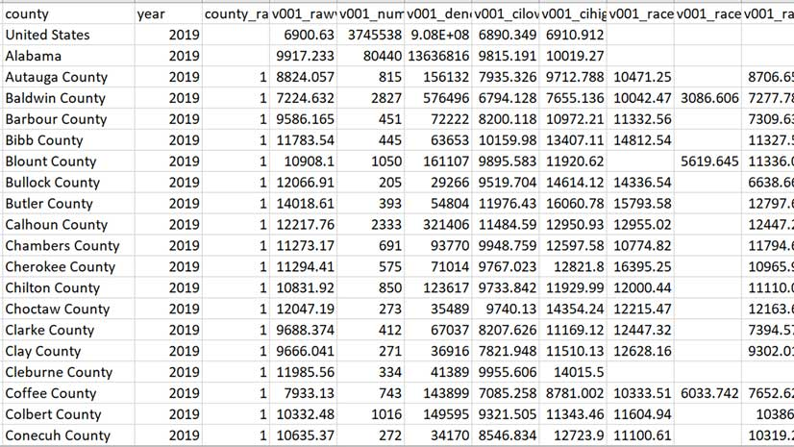
Filter (Cleaning, Organizing)

Slide 14
Filter (Cleaning, Organizing)
Including and excluding rows and columns
Finding out the missing values
Spaces, Commas, Zeros etc.
Tools: Excel, Google sheets, Open Refine

Slide 15
Analysing and visualising
Analysing and finding patterns (Tools: Excel, Google sheets etc.)
Basic visualizations
Percentage, percentage change, arithmetic mean etc.
In this step we extract information out of the data

Slide 16
Communicate
Writing the story
Creating the visualizations (Tools: Flourish.studio, Datawrapper etc.)
Some decisions – What kind of visualization, order of the information etc.

Slide 17
Crowdsourcing in data journalism
Inviting the people to the act of reporting task- news gathering, data collection or analysis through targeted open call form input; personal experiences, documents or other contribution.
There are some pitfalls.

